Slide 1

COVID-19 TRACKER

Slide 2
GROUP MEMBERS
Raza Ahmed (1912363)
Syed Murtaza Hussain Abidi (1912371)
Muhammad Zain Noorani (1912358)

Slide 3
INTRODUCTION
THE PROJECT IS A COVID – 19 TRACKER TRACKING THE DATA OF THOSE PEOPLE AFFECTED BY CORONA VIRUS IN PAKISTAN.
SOME OF THE FEATURES INCLUDES :
SPLASH SCREEN
DASHBOARD
PATIENTFORM
CHATBOT
ABOUT US

Slide 4
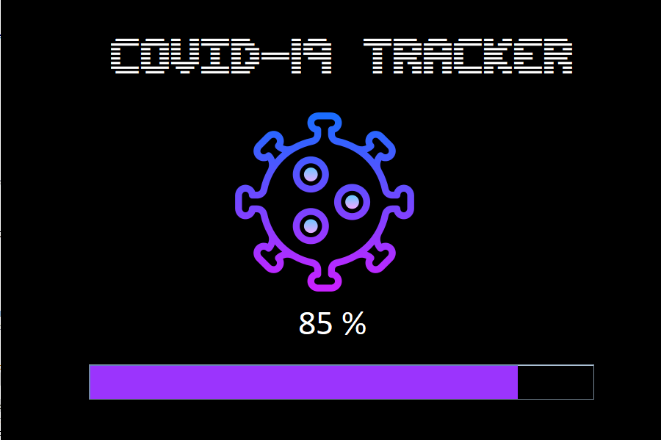
Splash screen

Slide 5
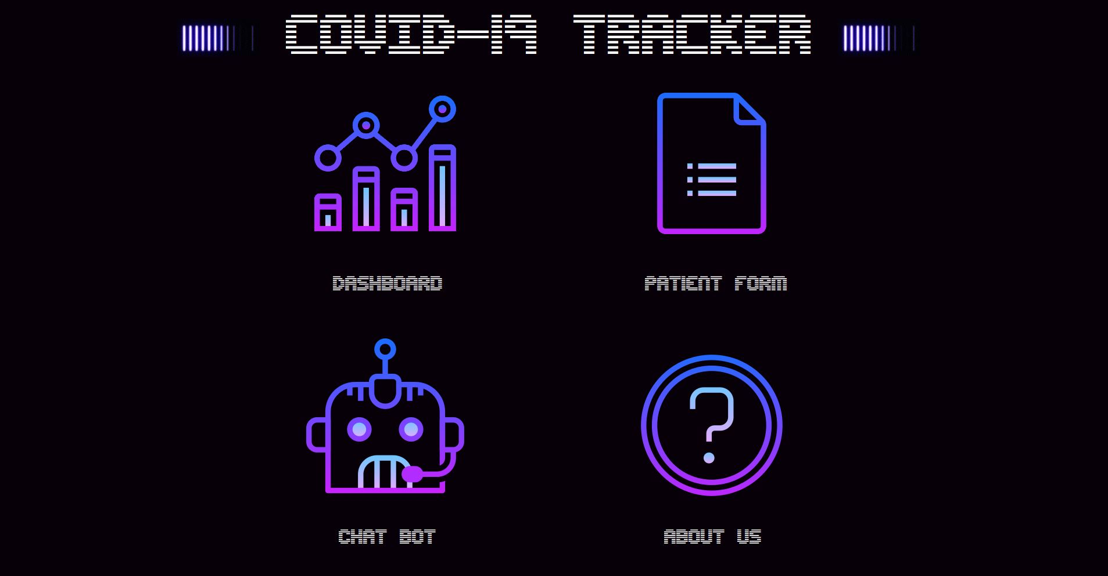
Main screen

Slide 6
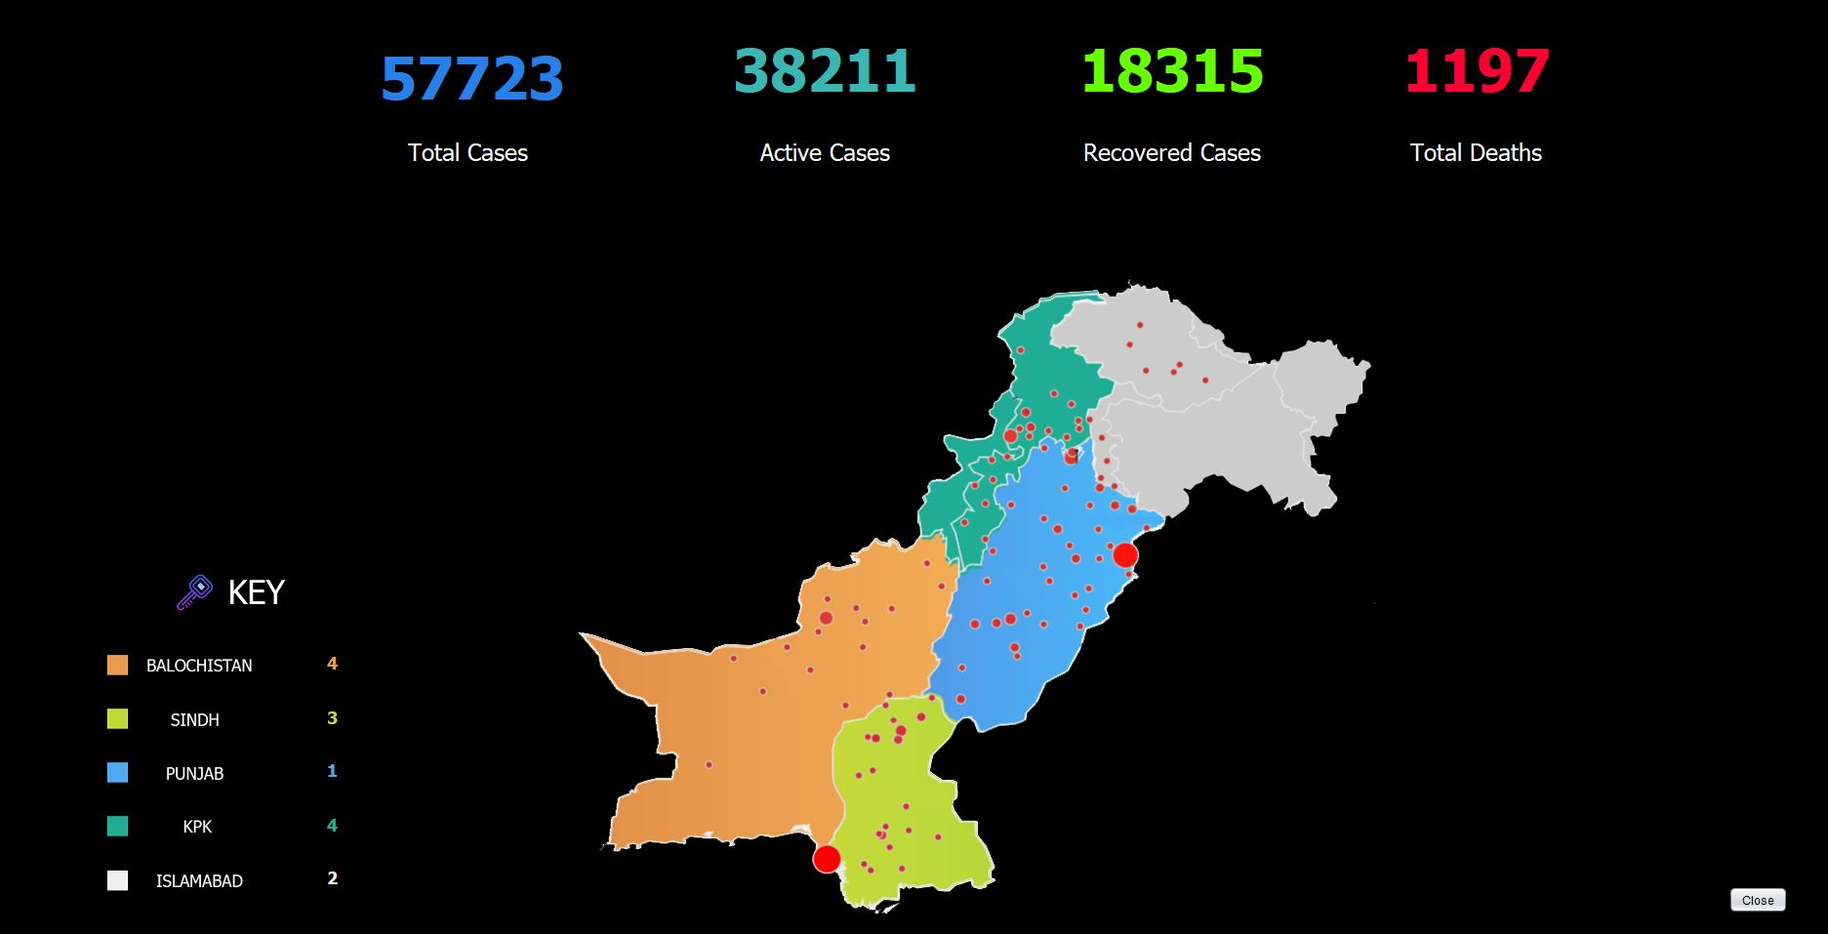
dashboard

Slide 7
DASHBOARD FUNCTIONALITY
THE DASHBOARD CONSISTS OF 4 COUNTERS COUNTING :
TOTAL CASES
ACTIVE CASES
RECOVERED CASES
DEATHS
THESE 4 COUNTERS WORKS ON THE CONCEPT OF FILING
THE KEY FEATURE OF THE DASHBOARD IS CONNECTED TO THE JTABLE WHICH COUNTS THE ACTIVE CASES OF THE CORONA PATIENTS ACCORDING TO THEIR RESPECTIVE PROVINCE THIS CONCEPT WORKS ON QUERIES.

Slide 8
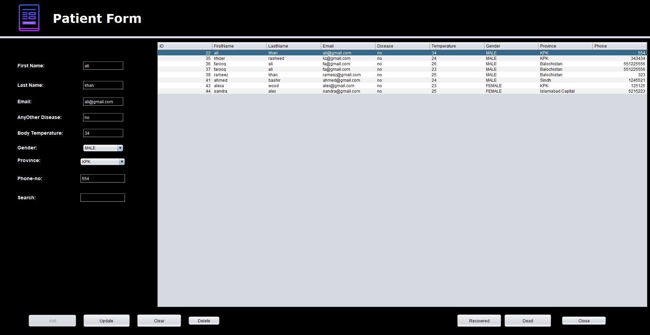
Patient form

Slide 9
PATIENT FORM FUNCTIONALITY
THE PATIENT FORM CONSISTS OF A JTABLE THAT IS CONNECTED TO MYSQL.
PATIENTS NAME , AGE , PROVINCE ETC CAN BE ENTERED AND STORED IN THE DATABASE.
THIS DATA CAN FURTHER BE MANIPULATED LIKE ADDING , DELETING , UPDATING THE RECORDS.
THE PATIENT CAN ALSO BE DECLARED DEAD/RECOVERED USING THE RESPECTIVE BUTTONS.
THE DATA MANIPULATED IS REFLECTED IN THE DASHBOARD SUCH AS FOR EXAMPLE : IF A PATIENT IS DECLARED DEAD/RECOVERED THE COUNTERS IN THE DASHBOARD ARE INCREMENTED OR DECREMENTED AS REQUIRED.

Slide 10
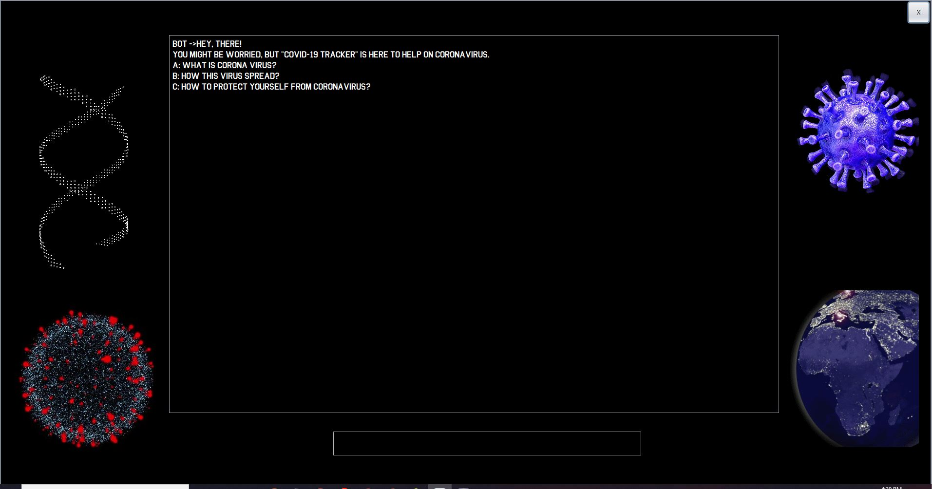
Chat bot

Slide 11
CHAT BOT FUNCTIONALITY
THE PROJECT HAS A HARD CODED CHATBOT THAT HAS LIMITED INPUTS IT WORKS ON SIMPLE IF/ELSE LOGIC.
THE INPUTS COULD BE ONLY A,B OR C IF ANY OTHER INPUT IS USED IT WILL BE CONSIDERED AS AN INVALID INPUT.
THE BASIC PURPOSE OF THIS CHATBOT IS FOR THE AWARENESS AND PRECAUTIONARY MEASURES OF CORONA VIRUS.

Slide 12
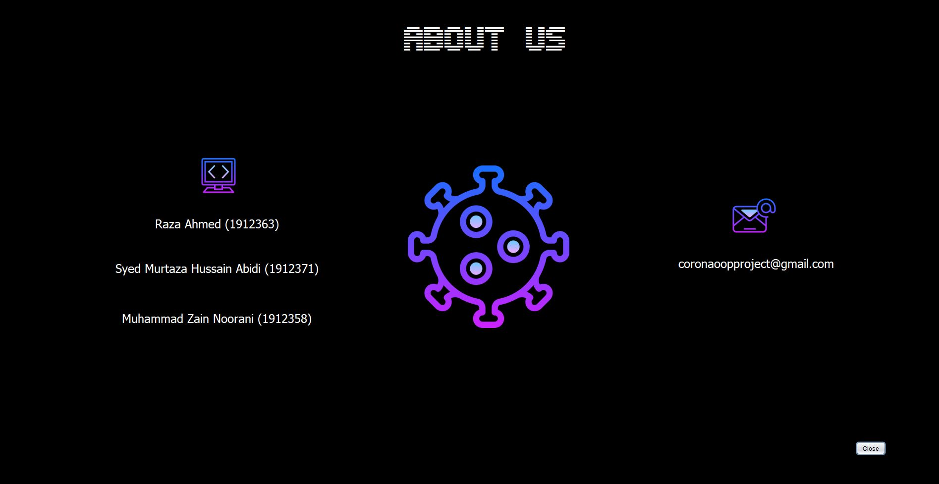
About us

Slide 13
APPLIED OOP PRINCIPLES
INHERITANCE
FILING
JDBC
EXCEPTION HANDLING
CLASS
OBJECT
PACKAGES

Slide 14
CONTRIBUTIONS
RAZA AHMED : GUI UI/UX DESIGN, SPLASH SCREEN,JDBC (MYSQL)
SYED MURTAZA HUSSAIN ABIDI : PATIENT FORM , JDBC (MYSQL)
MUHAMMAD ZAIN NOORANI : CHAT BOT,DASHBOARD , JDBC (MYSQL)

Slide 15
PROGRESS OF PROJECT
THE PROJECT IS
100 %
COMPLETED

Slide 16
THANK YOU

